Slide 1
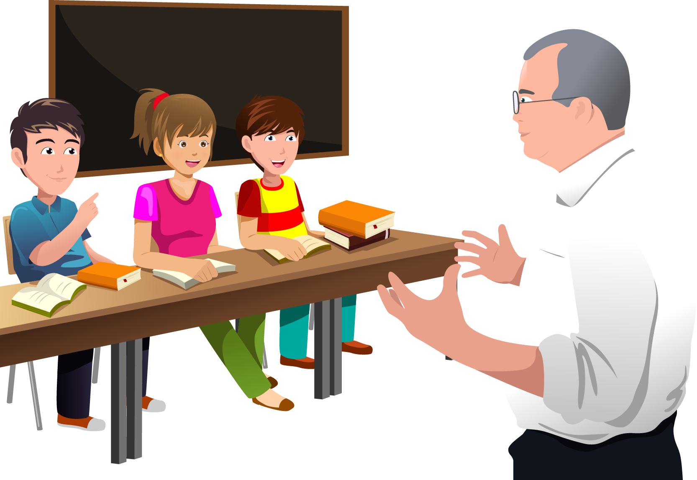
Welcome to my Middle School: Le collège Louis Leprince Ringuet

Slide 2
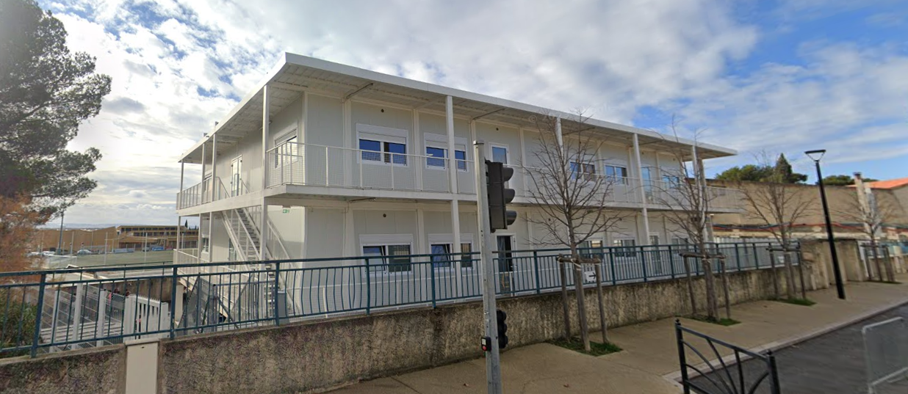
Who am I?
Hello, my name is Raphaël, I am in 6°c .
I am eleven, I live in La Fare Les Oliviers and I was in Paul Doumer.

Slide 3
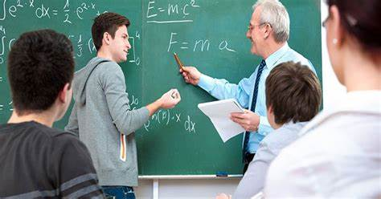
A new environment
In my Middle school, there is a playground and there are
sports fields...There is a head teatcher. There are supervisors.
I have got old friends: Aurélien and Jules.
I have got new friends:Tom and Ethan.

Slide 4
Rules are rules!
You can read comics in the school library.
You can eat in the dining hall but you can’t eat chewing gum in the classroom.
You can’t use your mobile in the playground.
You can speak with your friends in the playground but you can’t speak with your friends in the classroom.

Slide 5
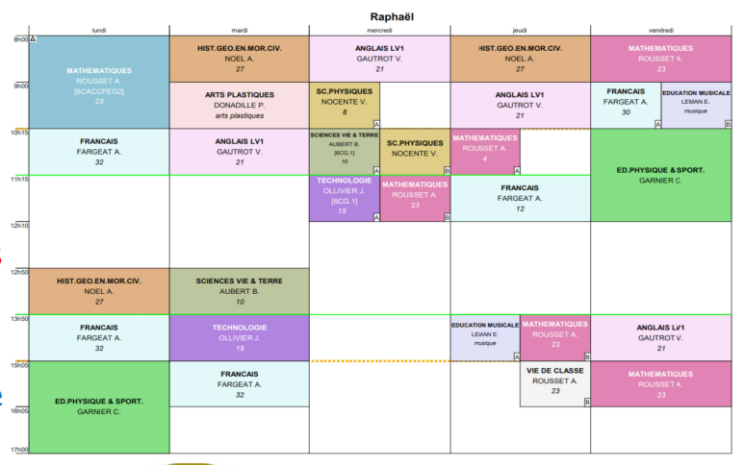
My timetable & my feelings
Generally,I start at eight o’clock.
I have got school on Wednesdays.
I have got one free period.
I’ve got arts from nine to ten.
Generally, I finish at four o’clock.
My favourite school subject is Maths because it is interesting for me.
I prefer Mondays because there are different subjects.
In middle school I am happy because it’s different from elementary school.
It’s cool because I finish before 4:30.
Don’t worry , the teacher are cool!

