Slide 1
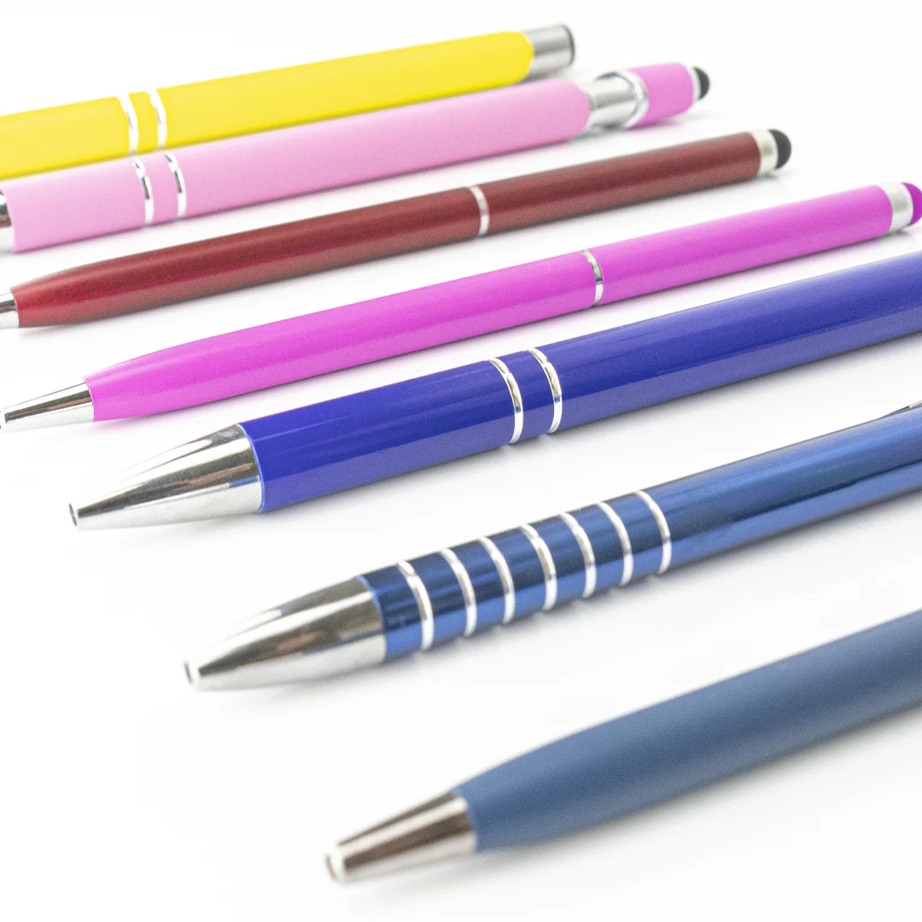
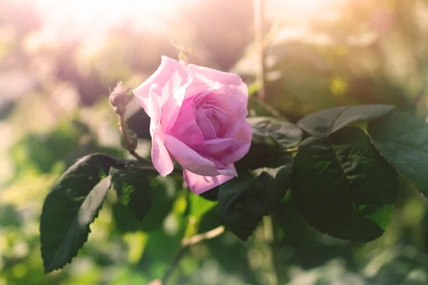
Welcome to my Middle School: Collège Louis Leprince Ringuet

Slide 2
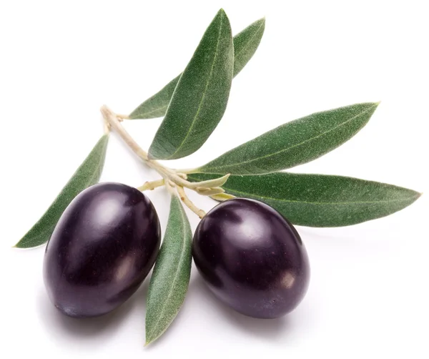
Who am I ?
Hello,my name is Kali.
My class is 6ème C .
I am 12 years old .
I live in La Fare les Oliviers .
I come from Paul Doumer in La Fare les Oliviers .

Slide 3
A new environment
In my Middle School, there is a nurse and a chief supervisor (CPE). I have got a Head teacher.
There are supervisors.
There is biology (svt) and ICT (technologie).
There is a library and a staffroom.
I have got old friends: Inès, Emma, Menel, Carmela…
I haven’t got new friends.

Slide 4
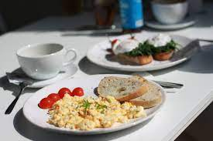
Rules are rules !
I can speak in the corridors.
But I can’t run in the corridors.
I can’t eat in the classroom.
But I can eat in the dining hall.

Slide 5
My timetable & my feelings
I start everyday at 8 o’clock. I have got 3 or 4 periods in the morning. I have got 1, 2 or 3 periods in the afternoon.
I have got 4 periods of English, I have got 5 or 6 periods of French and 3 or 4 periods of Maths in the week.
Lunchtime lasts 1 h 30 and breaks last 15 minutes.
I love history and French: they’re my favorite subjects. I don’t like biology and I hate ICT.
I prefer Thursdays week A because I finish at 3 o’clock p.m.
I’m happy in Middle School😀🎇❤🤍💙😀.

