Slide 1
Welcome to my Middle School :
Le collège Louis Leprice Ringuet

Slide 2
Who am I ?
Hello, my name is Justine.
I am 11 years old
I’m in 6th grade
I live in La Fare les Oliviers
I come from La Pomme de Pin in La Fare les Oliviers.

Slide 3
A new environement
- In my Middle School, there is a teacher for each class and I change rooms at the end of each class.
-There is not a gymnasium in the Middle School but outside there is one
We don’t finish every day at 4:30 pm, contrary to primary school
I have got old friends : Constance, Manon, Tessa, Alicia
And new friends : Romane, Eloise, Emma.

Slide 4
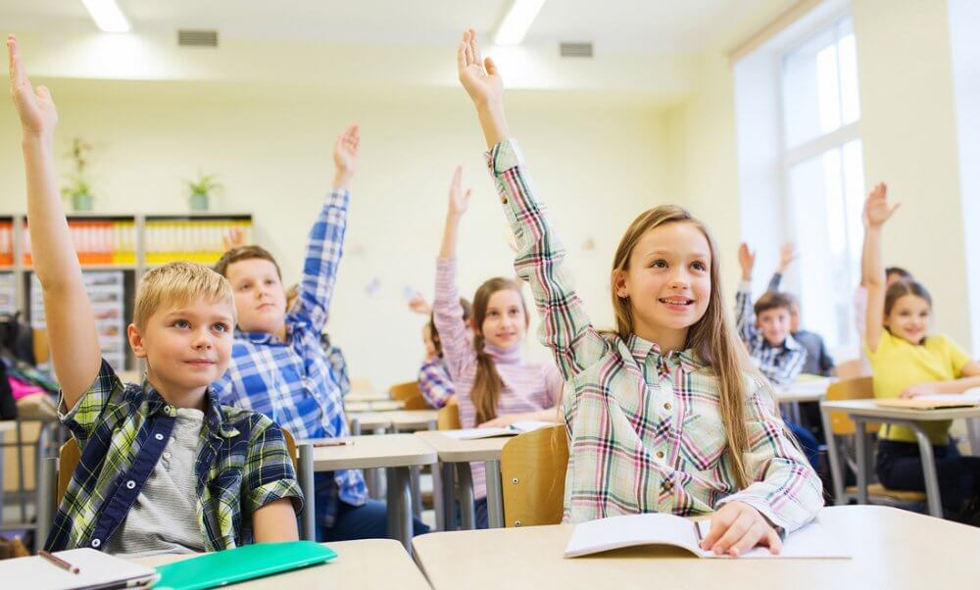
Rules are rules !
Help Me !
In class you can participate and help the class.
In class you can’t talk and use your mobile.

Slide 5
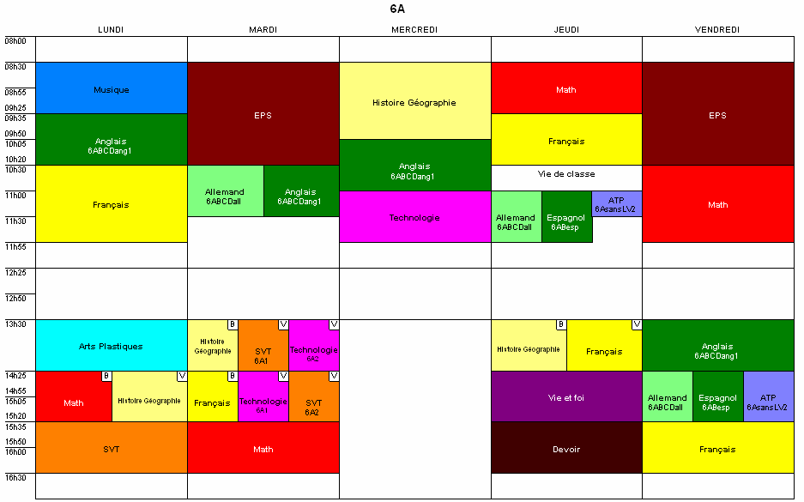
My timetable & my feelings
GOOD
Generally, I start at eight o’clock, and I finish at 4:00 pm.
In my timetable I have geography and history on Mondays, Tuesdays and Fridays.
In Middle School we have class on Wednesday mornings.
And we have 4 hours of sport every week
My favorite subject is Biology (Science and life of the earth) because we make a lot of experiments. So I love Wenesdays because I have Biology and ICT.
In my Middle School I’m fine, the teacher are so cool ☺ and funny. Don’t worry the Middle School is perfect !!!

