Slide 1
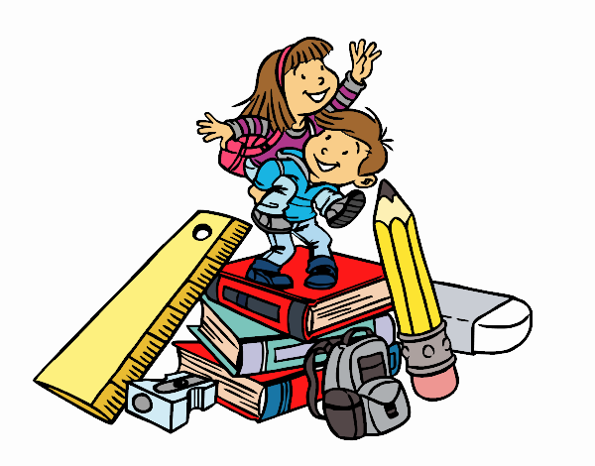
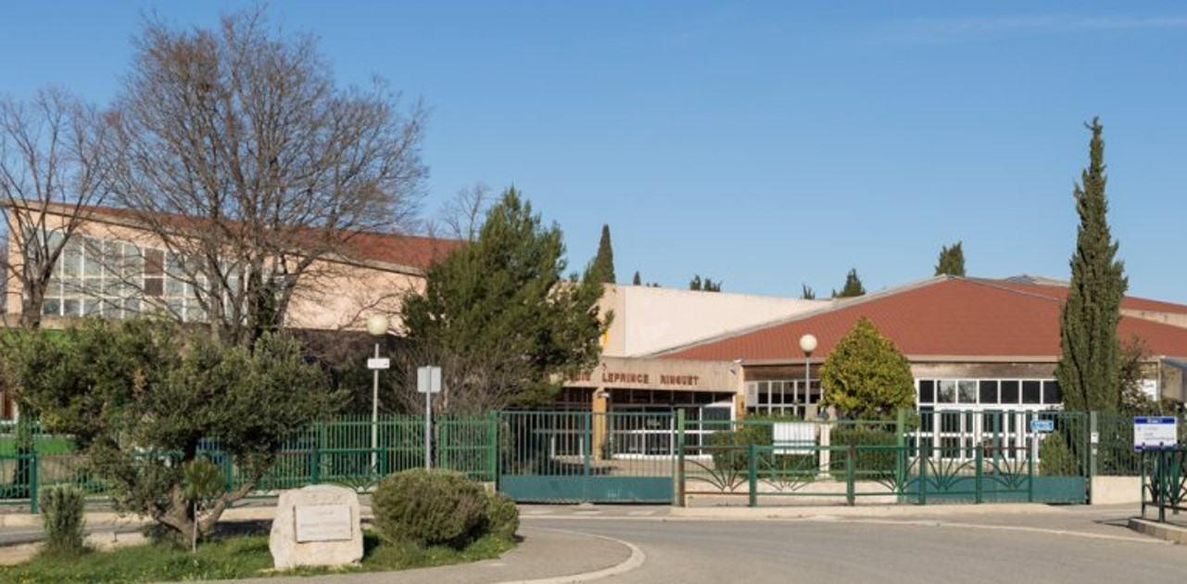
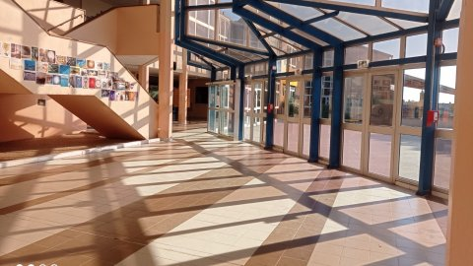
Welcome to my Middle School : Le collège Louis Leprince Ringuet

Slide 2
Who am I ?
Hello, my name is Ethan and I am in 6èmeC this year.
I am 11 years old, I live in Coudoux and I come from Daniel Germon school.

Slide 3
A new environment
In my Middle school, there is a playground, there are classrooms, a dining hall, a sport field, a gymnasium and a library. Also there are teachers, supervisors and 2 chief supervisors.
Then there are different subjects as History, Geography, Sciences, English, Maths, I.C.T, P.E, French, Music, Art…
I have got old friends : Tom, Milo and new friends : Aurélien, Jules.

Slide 4
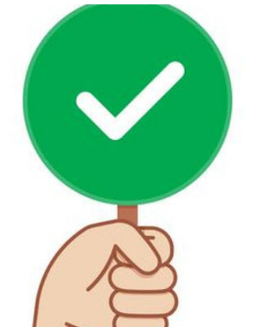
Rules are rules !
In my Middle school, we can’t run in the corridor. Also, we can’t insult the teachers and yell in the classroom.
But we can work and go to the library. Of course, we can play in the playground and eat at the dining hall.

Slide 5
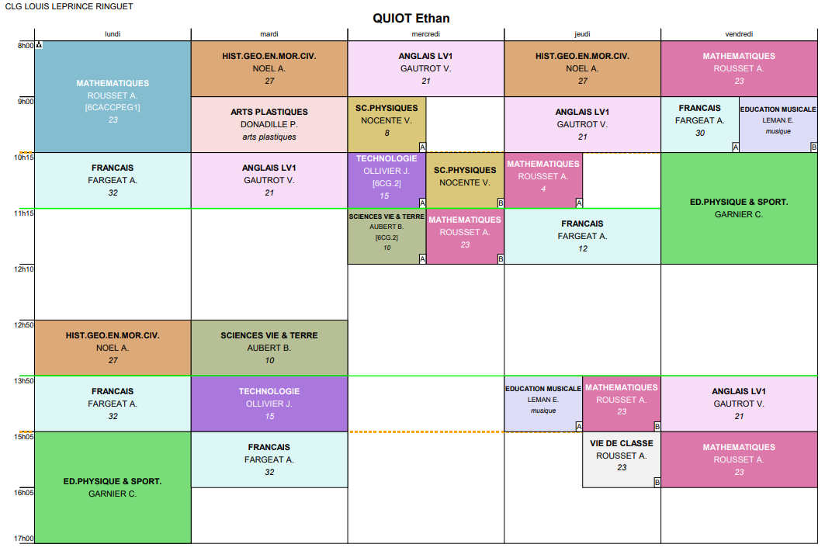
My timetable and my feelings
Generally, I start at eight o’clock and finish at four o’clock.
I have got three periods in the morning and three periods in the afternoon.
Generally, I have got lunchtime from twelve to one.
Then I have got two breaks everyday.
Also, I work on Wednesday mornings.
My favourite subjects are English and French. My favourite day is Wednesday because it is a short day
I am happy in middle school. Don’t worry and don’t stress because it is cool and then teachers are very nice.

