Slide 1
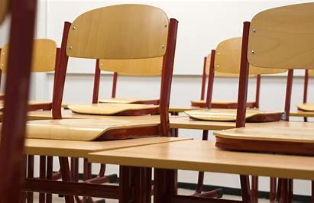
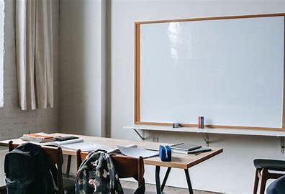
Welcome to my Middle School: Le collège Louis Leprince Ringuet

Slide 2
Who am I ?
Hello, my name is Aurélien.
I am in 6°C and I’m eleven years old.
I live in La Fare Les Oliviers.
Last year in CM2, I was in Paul Doumer.

Slide 3
A new environment
In my Middle school, there is a big playground. There are many classrooms too, one staffroom and one library.
There are seven hundred pupils, a lot of teachers and supervisors.
I learn news subjects as science, English, art and of course maths, French, geography and history.
I have got old friends: Théo, Jules… I’ve got new friends: Tom, Ethan...

Slide 4
Rules are rules!
I can choose my dessert in the cafeteria.
I can go to the school library when I want.
We can’t run in the corridors and of course we can’t use our mobile.

Slide 5
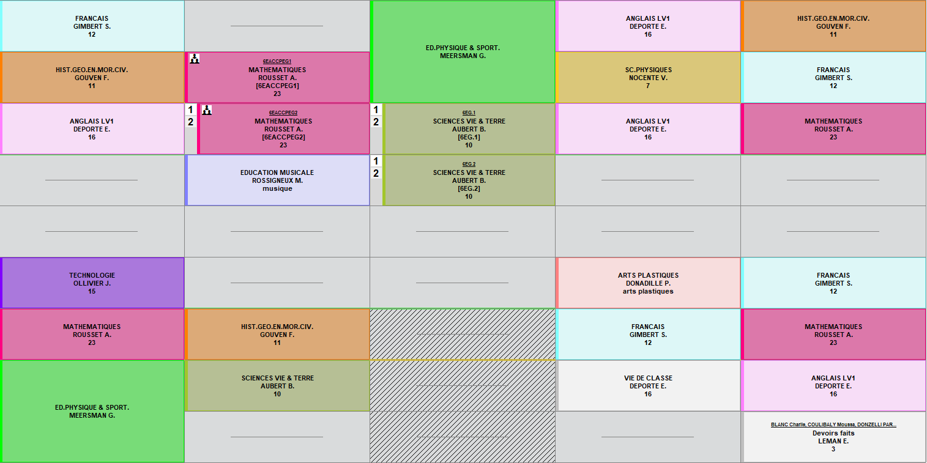
My timetable & my feelings
Generally, I start at eight o'clock and I finish at four o’clock.
On Mondays, I've got a double period of sport. On Tuesdays, I’ve got English from nine to ten. On Wednesdays, I finish at twelve ten. On Fridays, I’ve got music from nine to ten.
I like ICT because I love computers. I love maths because I like calculating. I prefer Thursdays because I generally finish early.
Middle school is soooo cool!
I’m very lucky, my English teacher is very kind.

