Slide 1
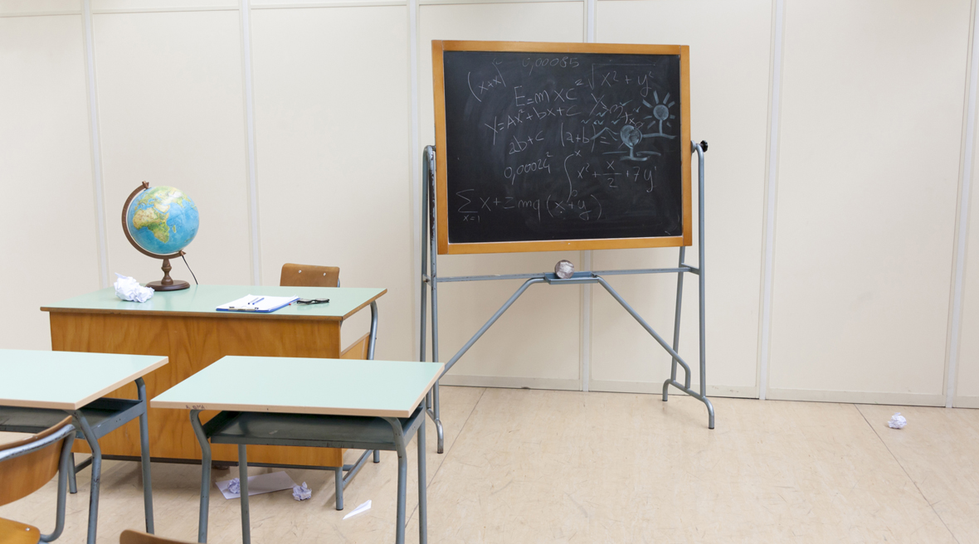
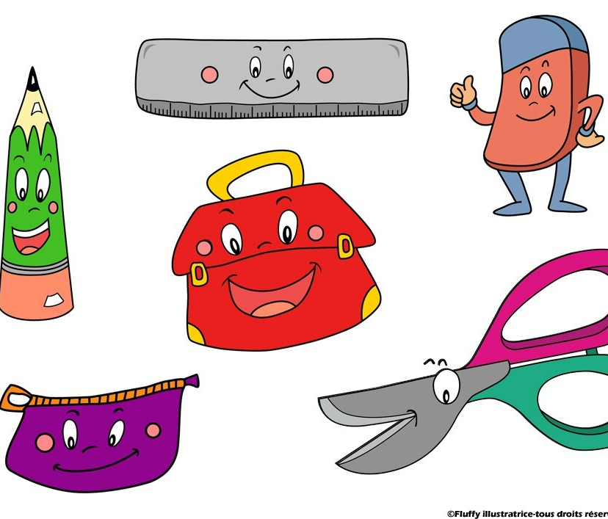
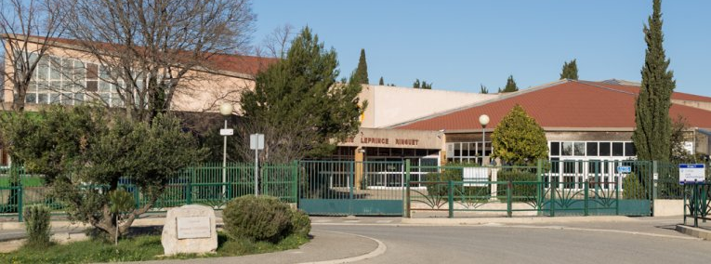
Welcome to my Middle School: Le collège Louis Leprince Ringuet

Slide 2
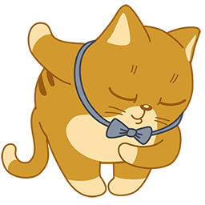
Who am I ?
Hello,my name is Faustine, I'm eleven years old , I am in 6F and I live in La Fare les Oliviers . I come from La Pomme de Pin, in La Fare les Oliviers

Slide 3
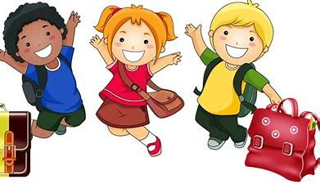
A new environment
In my Middle school, there are 25 classes, 680 pupils and 52 teachers . There is a school library , a nurse , a head teacher , a dining hall, a music classroom … there are also science labs and classrooms . I have got old friends: Constance ,Lilas ,Tara , Noémie,Jérémy,Lucas, Livio, … and new friends: Leeloo, Elona , Léa ...

Slide 4
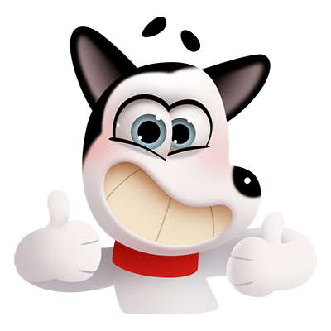
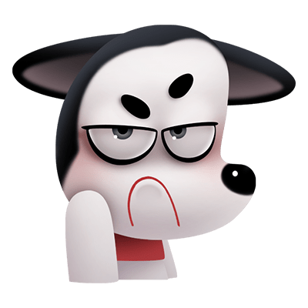
Rules are rules!
- You can eat in the dining hall - You can run in the playground
- You can't eat chewing gum in the
classroom - You can't use your mobile in the
Middle school

Slide 5
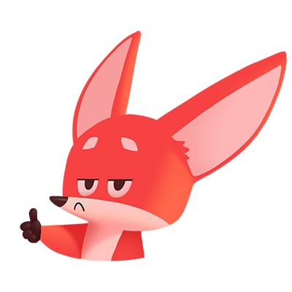
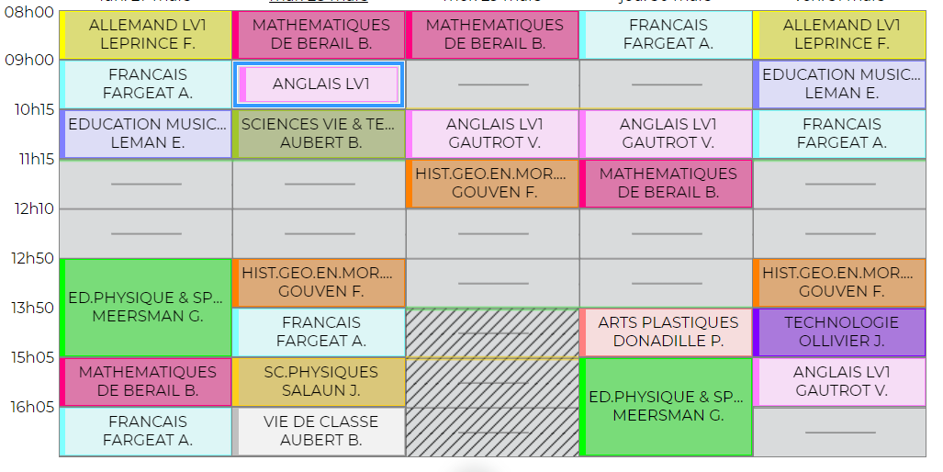
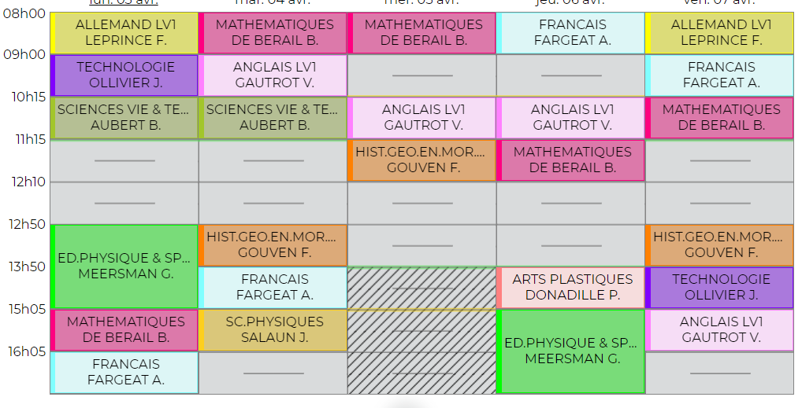
My timetable & my feelings
Generally, I start at 08:00 and I finish at 05:00 or 04:00 . On Wednesdays I start at 08:00 and I finish at 12:10, but I have got a free period !!! I have got two free periods in the week ! On Fridays and Tuesdays Week B, I finish at 04:00 . Ho, I have got week A and B !!! My favorite subjects are French because it's very interesting and I love English because the teachers is very cool. I love Science and History Geography too! I like maths and biology. But I don't like music . This year, the day I prefer is Friday because I have got History, English and French and I finish at 04:00 !!!
I love my middle school !!! I'm fine . So Relax, the teachers are perfectly perfect !!!

