Slide 1
Welcome to my Middle School : Le Collège Louis Leprince Ringuet

Slide 2
Who am I ?
Hello!
My name is Sindiély
I am eleven years old and I am in 6A
I live in La Fare Les Oliviers
Last year, I was in La Pomme de Pin in La Fare les Oliviers.

Slide 3
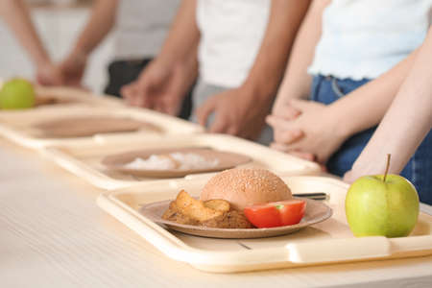
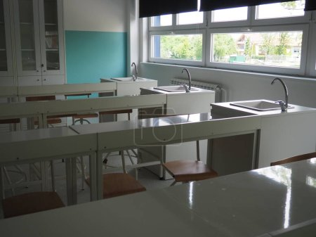
A new environment
In my Middle school, there is a self service at the dining hall
and there are new subjects: I.C.T, science and physics.
There is one teacher by school subject.
I have got an old friend, Ilena, and a new friend, Ornéla.

Slide 4
Rules are Rules!
In Middle Shool you can:
choose what you eat at the dining hall
go to the school library to read books
In Middle School you can’t:
eat chewing gum
use your mobile

Slide 5
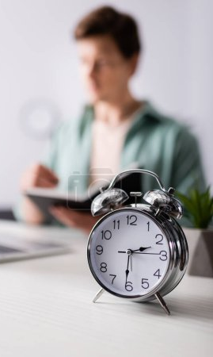
My timetable & my feelings
Generally,I start at 8am and I finish at 4pm or 5pm.
The lunchtime is from 11:15 to 12:45 or from 12:10
to 1:45.
I have classes on Wednesday mornings with a
double period of P.E.
Every day exept on Fridays I start my day with English!
And I never finish a school day with the same subject.
My favourite subject is history because the teacher
is fun and I like French and English too.
My favorite day is Friday because I finish early.
Don’t worry, it’s cool the teachers are nice and
ready to listen to you!

