Slide 1
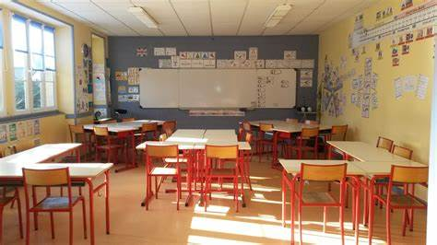
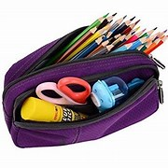
Welcome to my Middle School: Le Collège Louis Leprince Ringuet

Slide 2
Who am I ?
Hello, my name is Chloé, I’m in Year 7 in the Middle school and I live in La Fare Les Oliviers.
Last year, I was in Paul Doumer.

Slide 3
A new environment
In my Middle school, there are very good teachers and there are eleven subjects but there isn’t a sport pitch and there isn’t a drama hall.
I have got old friends : Aurore and Sarah.
And new friends : Alicia and Laura.

Slide 4
Rules are rules!
You can eat in the dining hall and you can play in the playground.
But you can't run in the corridors and in the classroom too. You can't use your mobiles.

Slide 5
My timetable & my feelings
Generally, I have classes from 8 to 5 o'clock. In the morning I generally have got 3 periods and 4 periods in the afternoon. On Thursdays I have generally got a free period from 9 to 10 o'clock. OnWednesday generally, I am at school from 9 to 12:10.
At school, I love French : it’s my favorite subject. And I like German, English and Physics. This year, the day I prefer is Friday because it is the day before the week-end.
I'm happy in my middle school and don't worry, the teachers are perfectly perfect!

